Slide 1

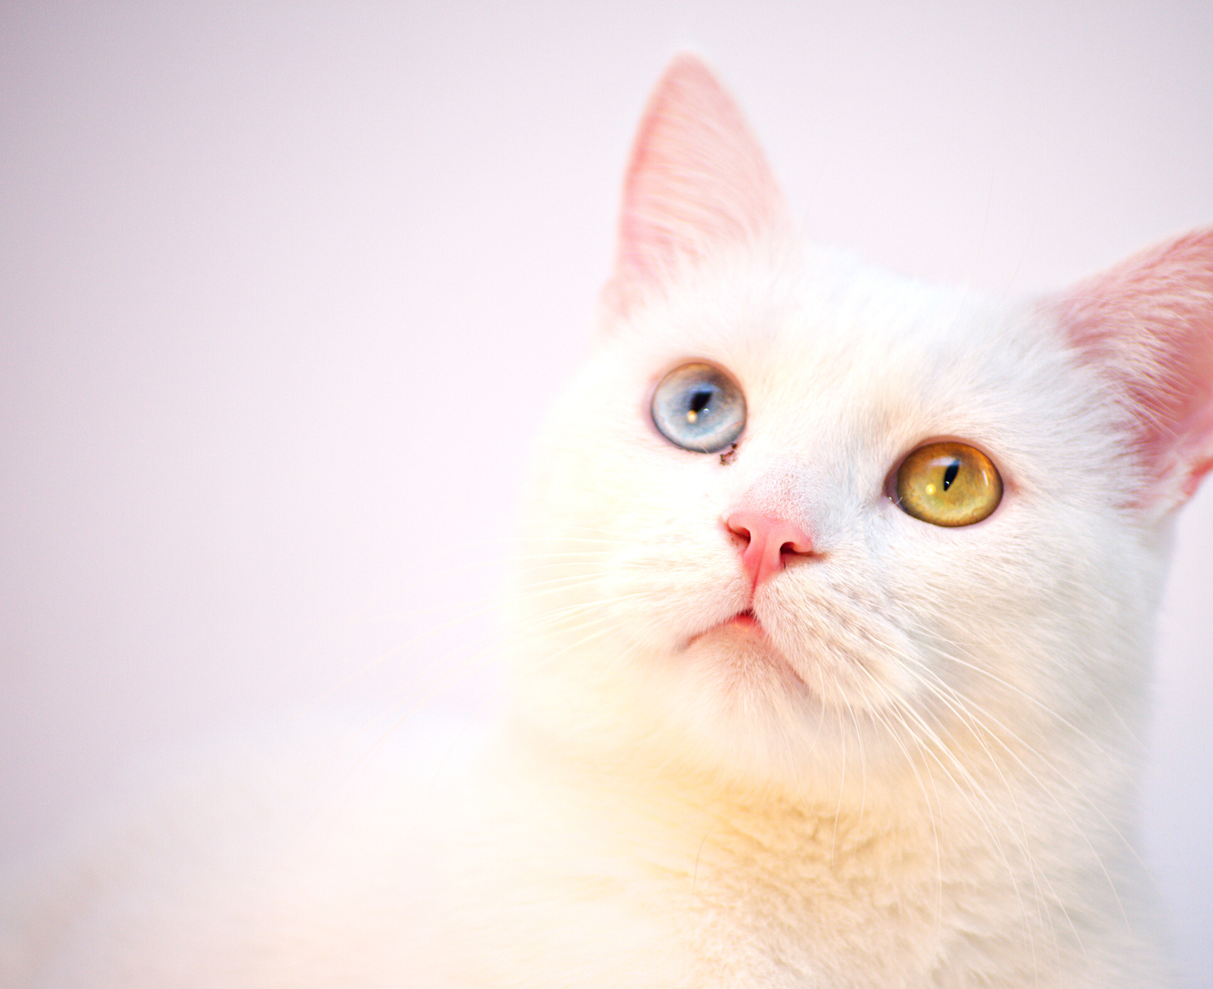

PET SHELTER
Author: Valeriia Lebedieva

Slide 2
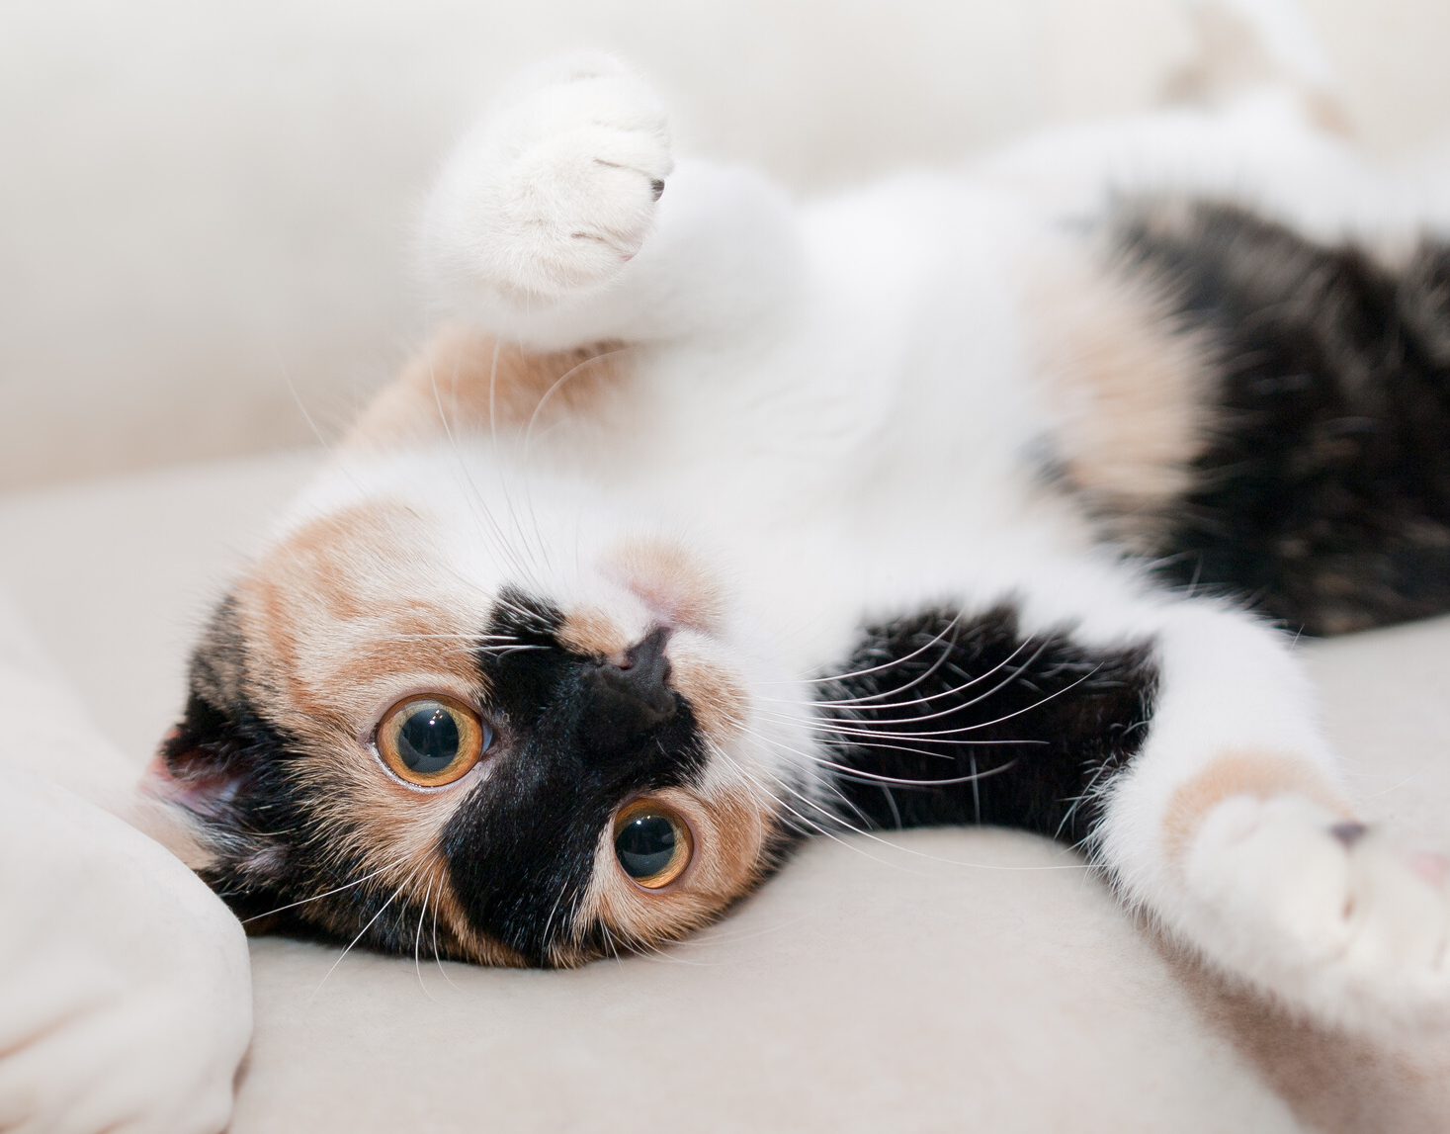
What is this
project
for?

Slide 3
Project goals
- adding and editing information about a new animal (sections for
cats and dogs)
- adding and editing useful information (articles, photos, videos)
on pet care in the “Posts” section
- sending notifications by email about a new post to all subscribers
- view current weather with automatic geolocation of your city and
exchange rates(REST service)
- Google authentication

Slide 4
Application creation steps:
1. Functional development, making a list of requirements
2. Implementation of the business layer of the application
3. Implementation of the client part of the application
4. Testing

Slide 5
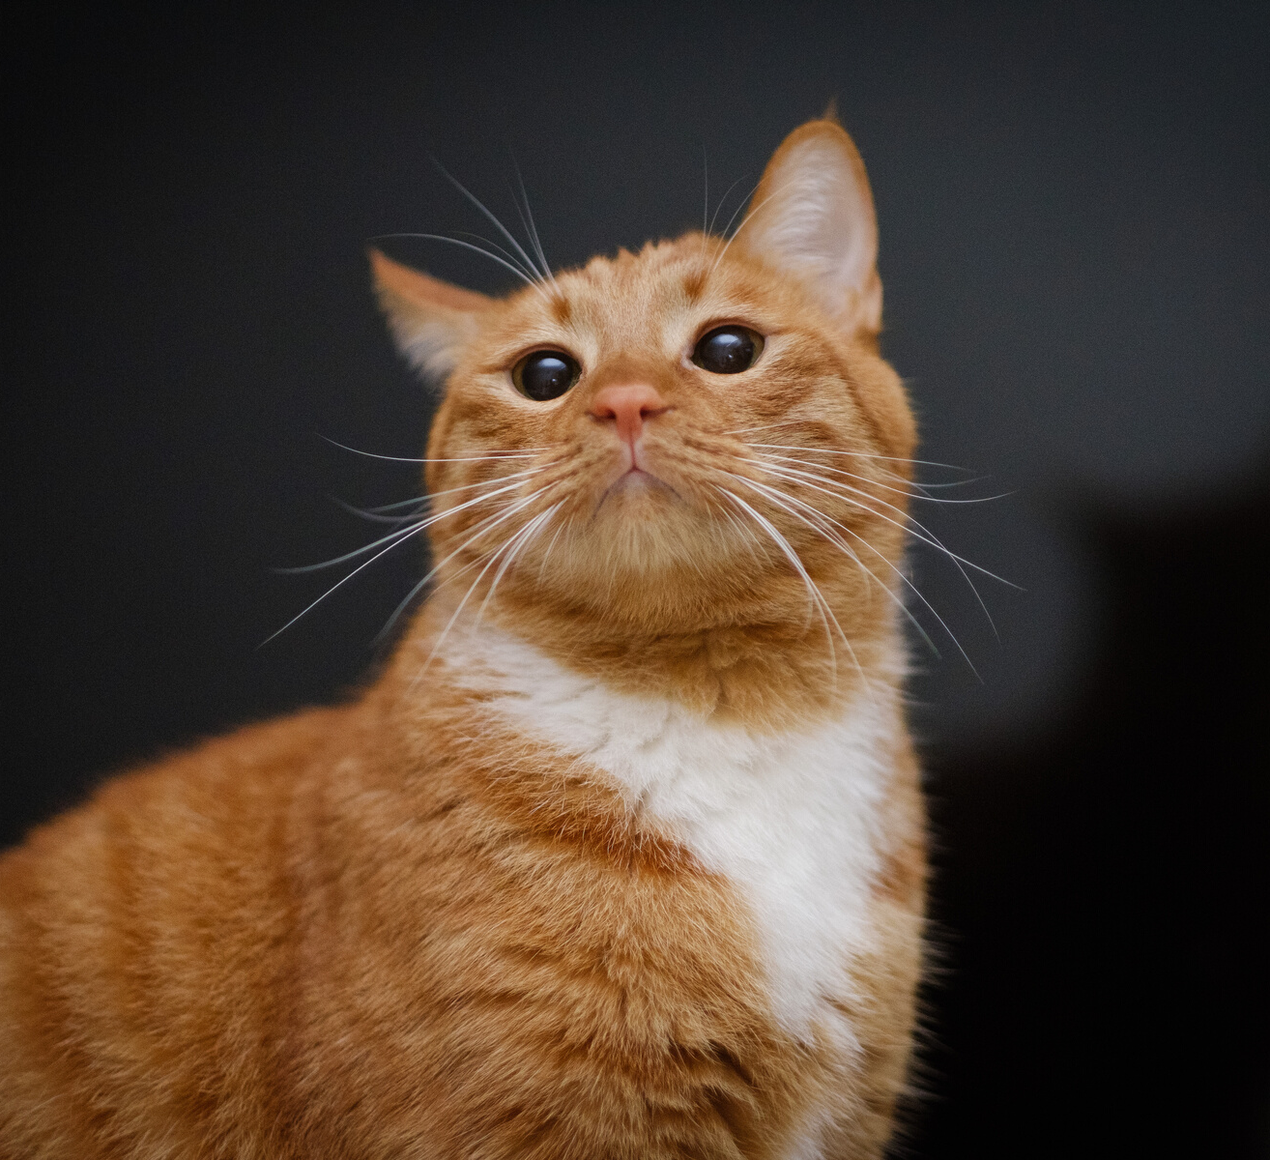
Technologies
- Spring Boot
- Spring Security
- Spring Data JPA
- Hibernate
- Mysql
- REST
- Ajax
- Thymeleaf
- Bootstrap
- HTML, CSS, js
- JUnit
- Rest Assured

Slide 6
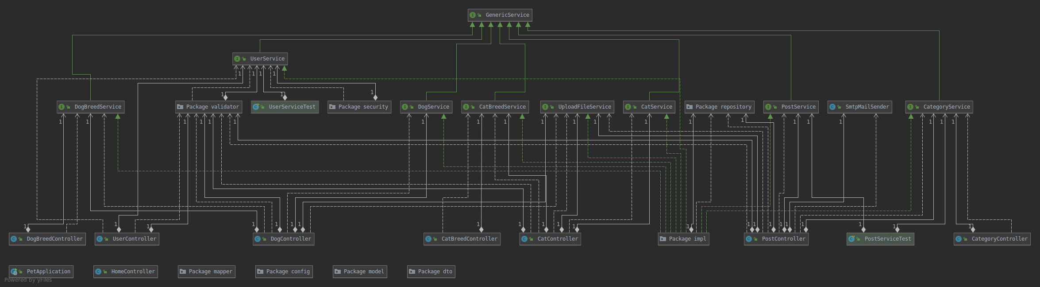
Class diagram

Slide 7
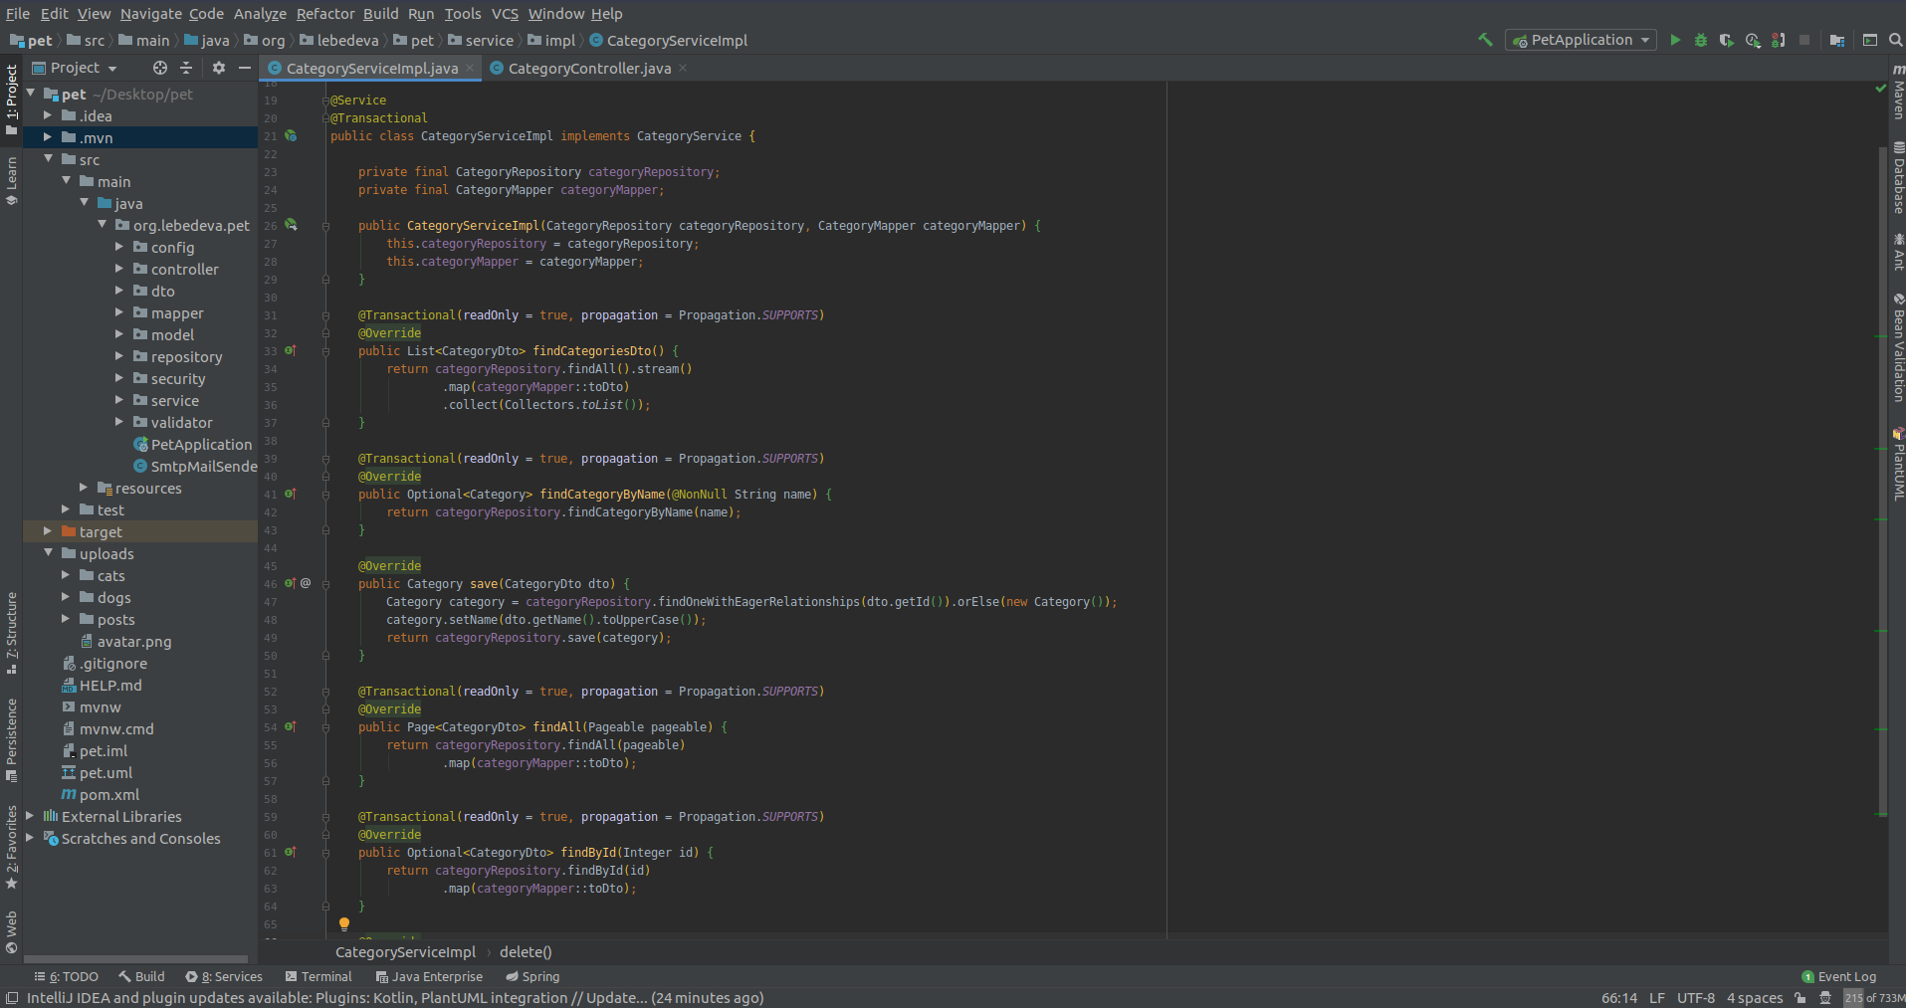
Service implementation

Slide 8
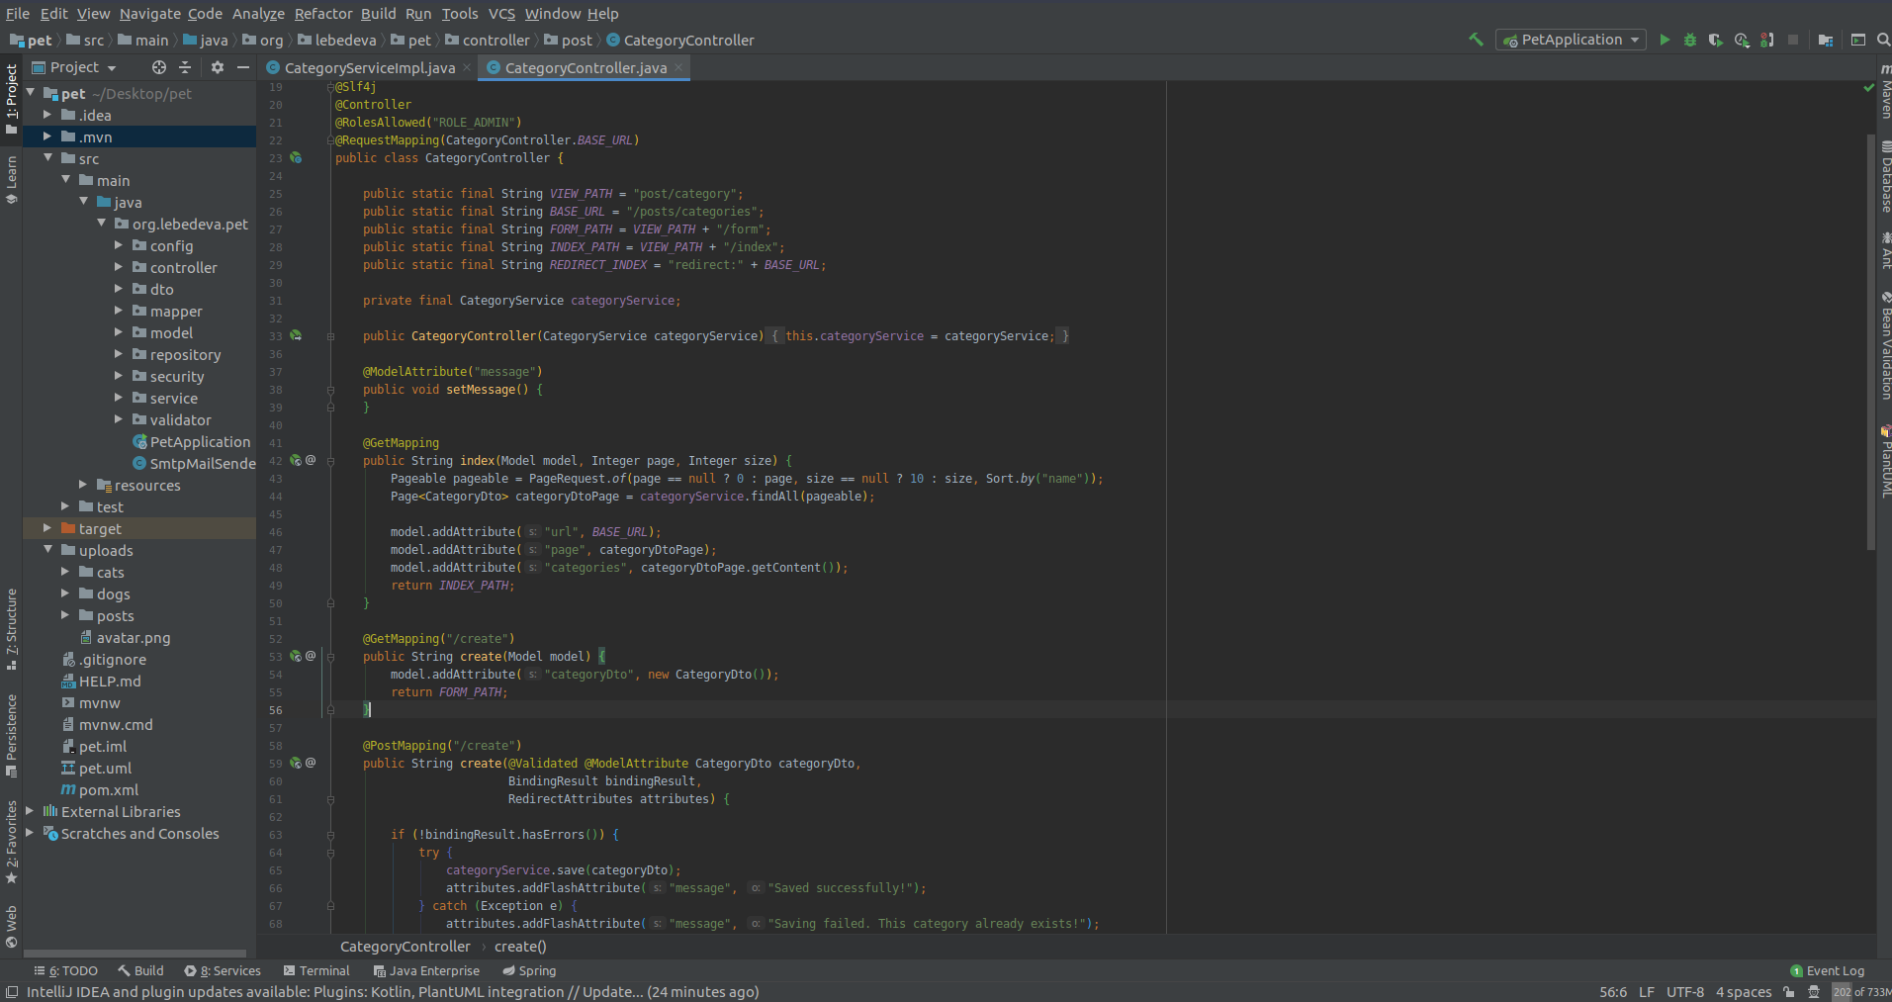
Controller

Slide 9
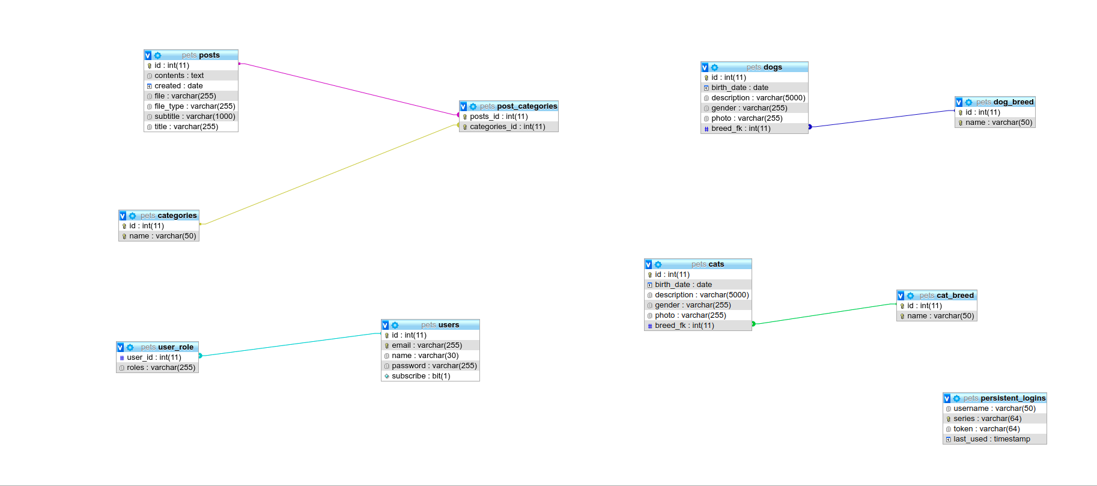
DB diagram

Slide 10
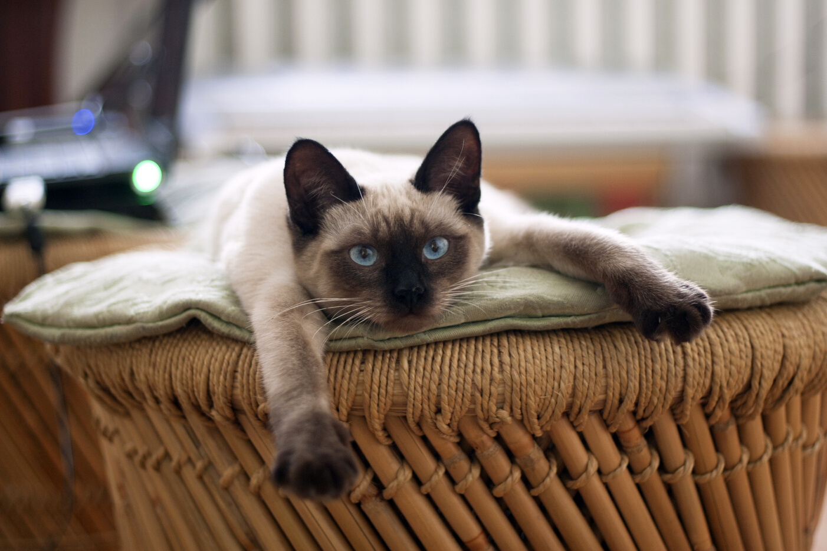
Thank you for the attention

